Slide 1
Module - 2 (Unit Testing)
Concept of Unit testing. Static Unit testing. Dynamic Unit testing - Control Flow testing, Data Flow testing, Domain testing, Functional Program testing. Mutation testing - Mutation and Mutants, Mutation
operators, Mutation score. Junit - Framework for Unit testing. Case Study - Mutation testing using Junit and Muclipse.

Slide 2
Testing for Developers
Check out the module
Write the code for the next feature to be implemented
Write unit tests to test the feature
Ensure that the code passes the unit tests
Get the latest code for the entire application
Make sure the whole project passes the integration tests
Check in code and unit tests

Slide 3
Unit testing, a testing technique using which individual modules are tested to determine if there are any issues by the developer himself.
It is concerned with the functional correctness of the standalone modules.
The main aim is to isolate each unit of the system to identify, analyze and fix the defects

Slide 4
Unit Testing - Advantages:
Reduces Defects in the Newly developed features or reduces bugs when changing the existing functionality.
Reduces Cost of Testing as defects are captured in very early phase.
Improves design and allows better refactoring of code.
Unit Tests, when integrated with build gives the quality of the build as well.

Slide 5
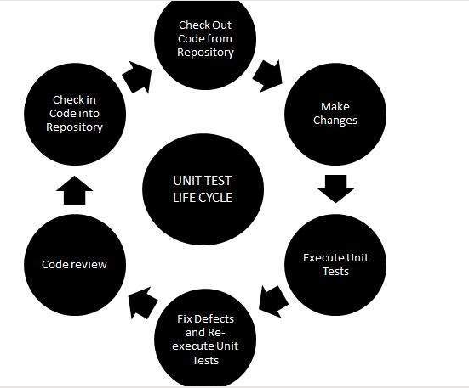
Unit Testing LifeCyle:

Slide 6
Unit Testing Techniques:
Black Box Testing - Using which the user interface, input and output are tested.
White Box Testing - used to test each one of those functions behavior is tested.
Gray Box Testing - Used to execute tests, risks and assessment methods.

Slide 7
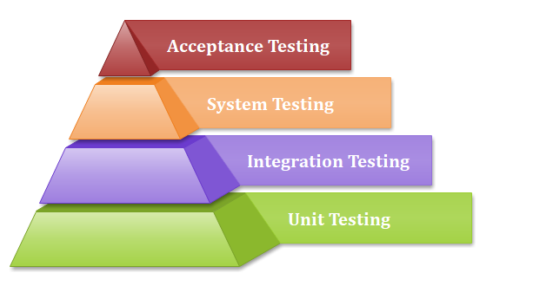
Why Unit Testing?
In a testing level hierarchy, unit testing is the first level of testing done before integration and other remaining levels of the testing.
It uses modules for the testing process which reduces the dependency of waiting for Unit testing frameworks, stubs, drivers and mock objects are used for assistance in unit testing.

Slide 8
Unit testing helps tester and developers to understand the base of code that makes them able to change defect-causing code quickly.
Unit testing helps in the documentation.
Unit testing fixes defects very early in the development phase that's why there is a possibility to occur a smaller number of defects in upcoming testing levels.
It helps with code reusability by migrating code and test cases.

Slide 9
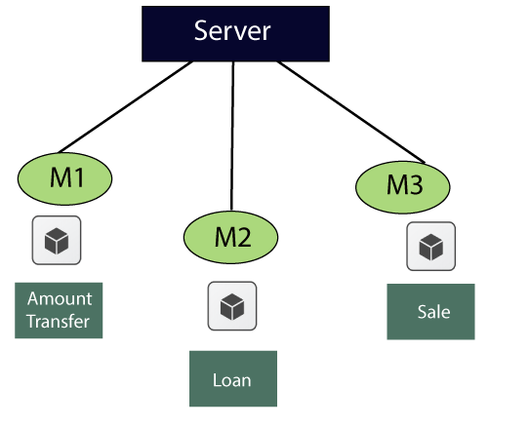
Example of Unit testing
Let us see one sample example for a better understanding of the concept of unit testing:

Slide 10
Unit Testing Tools
We have various types of unit testing tools available in the market, which are as follows:
NUnit
JUnit
PHPunit
Parasoft Jtest
EMMA

Slide 11
Unit Testing Techniques:
Unit testing uses all-white box testing techniques as it uses the code of software application:
Data flow Testing
Control Flow Testing
Branch Coverage Testing
Statement Coverage Testing
Decision Coverage Testing

Slide 12
How to achieve the best result via Unit testing?
Unit testing can give best results without getting confused and increase complexity by following the steps listed below:
Test cases must be independent because if there is any change or enhancement in requirement, the test cases will not be affected.
Naming conventions for unit test cases must be clear and consistent.
During unit testing, the identified bugs must be fixed before jump on next phase of the SDLC.
Only one code should be tested at one time.
Adopt test cases with the writing of the code, if not doing so, the number of execution paths will be increased.
If there are changes in the code of any module, ensure the corresponding unit test is available or not for that module.

Slide 13
Advantages
Unit testing uses a module approach due to any part can be tested without waiting for the completion of another part’s testing.
The developing team focuses on the provided functionality of the unit and how functionality should look in unit test suits to understand the unit API.
Unit testing allows the developer to refactor code after a number of days and ensure the module still working without any defect.

Slide 14
Disadvantages
It cannot identify integration or broad level error as it works on units of the code.
In the unit testing, evaluation of all execution paths is not possible, so unit testing is not able to catch each and every error in a program.
It is best suitable for conjunction with other testing activities.

Slide 15
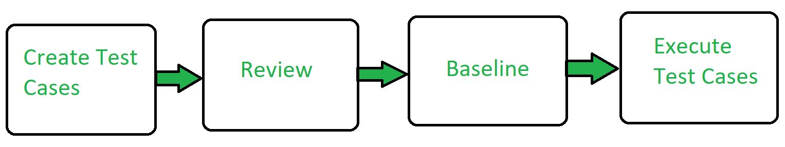
Workflow of Unit Testing:

Slide 16
Static Unit Testing:
Static Unit Testing is kind of testing where a software product should undergo a phase of inspection and correction at each milestone in its lifecycle.
In static unit testing, code is reviewed by applying techniques commonly known as inspection and walkthrough.
Inspection is a step-by-step peer group review of a work product, with each step checked against predetermined criteria and Walkthrough is a review where the author leads the team through a manual or simulated execution of the product using predefined scenarios.
At a certain milestone, the product need not be in its final form. For example, completion of coding is a milestone, even though coding of all units may not make the desired product.

Slide 17
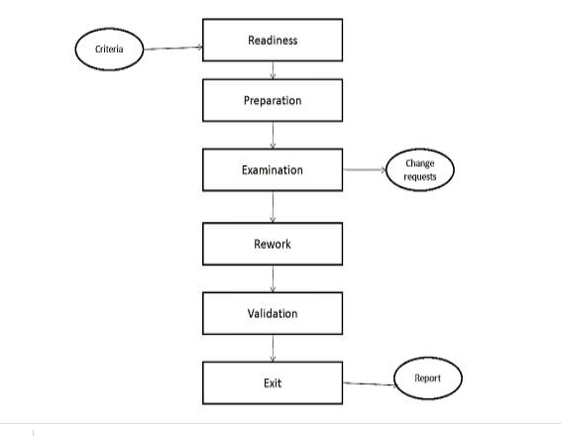
Static unit testing includes the code review process which consists of the following steps :

Slide 18
Dynamic Unit Testing :
Execution-based unit testing is referred to as dynamic unit testing.
In this testing, a program unit is actually executed in isolation.
However, this execution differs from ordinary execution in the following way:
A unit under test is taken out of its actual execution environment.
The actual execution environment is emulated by writing more code so that the unit and the emulated environment can be compiled together.
The above-compiled aggregate is executed with selected inputs.
The outcome of such execution is collected in a variety of ways, such as straightforward observation on the screen, logging on files, and software instrumentation of the code to reveal run time behavior.
The result is compared with the expected outcome.

Slide 19
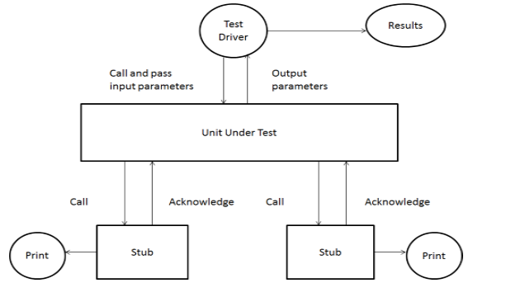

Slide 20
Dynamic Unit Testing environment:
An environment for dynamic unit testing is created by evaluating the context of the unit under test, as shown in the above figure.
The context of a unit test consists of two parts : (a) a caller of the unit and (b) all the units called by the unit.
The caller unit is known as a test driver, and all the emulations of the units called by the unit under test are called stubs. The test driver and the stubs are together called scaffolding.

Slide 21
1. Test Driver :
A test driver is a program that invokes the unit under test. The unit under test executes with input values received from the driver and, upon termination, returns a value to the driver.
The driver compares the actual outcome, that is, the actual value returned by the unit under test, with the expected outcome from the unit.
The test driver functions as the main unit in the execution process.
The driver not only facilitates compilation but also provides input data to the unit under test in the expected format.
2. Stubs:
A stub is a “dummy subprogram” that replaces a unit that is called by the unit under test.
Stubs replace the units called by the unit under test.
A stub performs two tasks. First, it shows evidence that the stub was, in fact, called. Such evidence can be shown by merely printing a message. Second, the stub returns a precomputed value to the caller so that the unit under test can continue its execution.

Slide 22
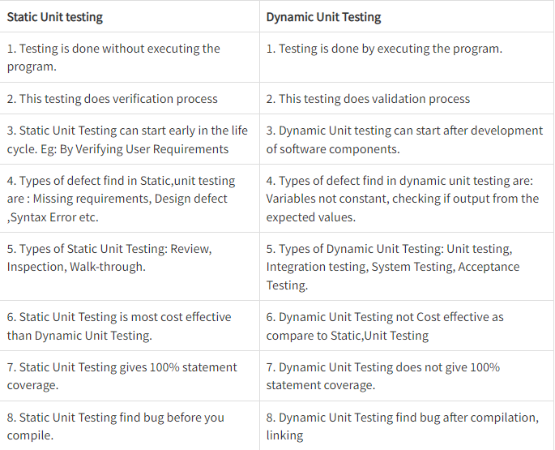
Difference between Static Unit Testing and Dynamic Unit Testing:

Slide 23
Control Flow Software Testing
Control flow testing is a type of software testing that uses program’s control flow as a model.
Control flow testing is a structural testing strategy. This testing technique comes under white box testing.
For the type of control flow testing, all the structure, design, code and implementation of the software should be known to the testing team.

Slide 24
This type of testing method is often used by developers to test their own code and own implementation as the design, code and the implementation is better known to the developers.
This testing method is implemented with the intention to test the logic of the code so that the user requirements can be fulfilled.
Its main application is to relate the small programs and segments of the larger programs.

Slide 25
Motivation
Control-flow testing is most applicable to new software for unit testing.
Control-flow testing assumptions:
specifications are correct
data is defined and accessed properly
there are no bugs other than those that affect control flow
Structured and OO languages reduce the number of control-flow bugs.

Slide 26
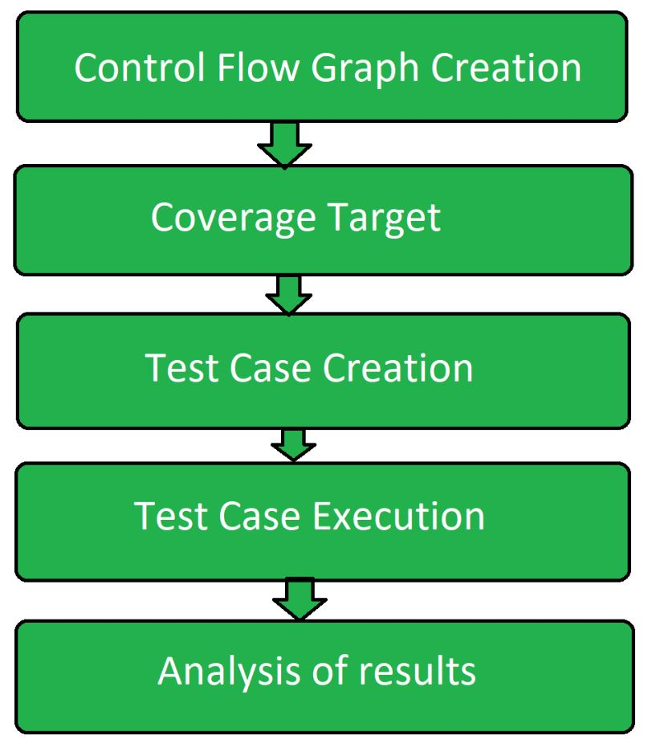
Control Flow Testing Process:
Following are the steps involved into the process of control flow testing:

Slide 27
Control Flow Graph Creation: From the given source code a control flow graph is created either manually or by using the software.
Coverage Target: A coverage target is defined over the control flow graph that includes nodes, edges, paths, branches etc.
Test Case Creation: Test cases are created using control flow graphs to cover the defined coverage target.
Test Case Execution: After the creation of test cases over coverage target, further test cases are executed.
Analysis: Analyze the result and find out whether the program is error free or has some defects.

Slide 28
Control Flowgraphs
The control flowgraph is a graphical representation of a program’s control structure.

Slide 29
Flowgraphs Consist of Three Primitives
A decision is a program point at which the control can diverge.
(e.g., if and case statements).
A junction is a program point where the control flow can merge.
(e.g., end if, end loop, goto label)
A process block is a sequence of program statements uninterrupted by either decisions or junctions. (i.e., straight-line code).
A process has one entry and one exit.
A program does not jump into or out of a process.

Slide 30
IF Diagram

Slide 31
IF-THEN-ELSE Diagram

Slide 32
FOR or WHILE Diagram

Slide 33
Example Code Fragment

Slide 34
White-box Test Methods
Statement Coverage
Decision/Branch Coverage
Condition Coverage
Decision/Condition Coverage
Path Coverage

Slide 35
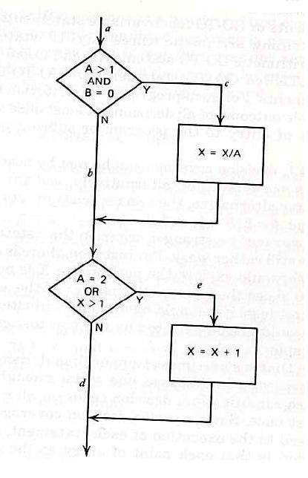
Example Code Fragment
If ((A>1) & (B=0)) then Do;
X=X/A;
END;
If ((A==2) | (X>1)) then Do;
X=X+1;
END;
END;

Slide 36
Statement Coverage
Exercise all statements at least once
How many test cases?
A=2 and B=0 (ace)

Slide 37
Decision/Branch Coverage
Each decision has a true and a false outcome at least once
How many test cases?
A=2 and B=0 (ace)
A=1 and X=1 (abd)

Slide 38
Condition Coverage
Each condition in a decision takes on all possible outcomes at least once
Conditions: A>1, B=0, A=2, X>1
How many test cases?
A=2, B=0, and X=4 (ace)
A=1, B=1, and X=1 (abd)

Slide 39
Decision/Condition Coverage
Each condition in a decision takes on all possible outcomes at least once, and each decision takes on all possible outcomes at least once
How many test cases?
A=2, B=0, and X=4 (ace)
A=1, B=1, and X=1 (abd)
What about these?
A=1, B=0, and X=3
A=2, B=1, and X=1

Slide 40
Multiple Condition Coverage
Exercise all possible combinations of condition outcomes in each decision
Conditions:
A>1, B=0
A>1, B<>0
A<=1, B=0
A<=1, B<>0
A=2, X>1
A=2, X<=1
A<>2, X>1
A<>2, X<=1

Slide 41
Path Coverage
Every unique path through the program is executed at least once
How many test cases?
A=2, B=0, X=4 (ace)
A=2, B=1, X=1 (abe)
A=3, B=0, X=1 (acd)
A=1, B=1, X=1 (abd)

Slide 42
Bubble Sort Algorithm
1 for (j=1; j<N; j++) {
last = N - j + 1;
2 for (k=1; k<last; k++) {
3 if (list[k] > list[k+1]) {
temp = list[k];
list[k] = list[k+1];
list[k+1] = temp;
4 }
5 }
6 }
7 print(“Done\n”);
1
2
3
4
5
6
7

Slide 43
Path testing
The objective of path testing is to ensure that the set of test cases is such that each path through the program is executed at least once.
The starting point for path testing is a program flow graph that shows nodes representing program decisions and arcs representing the flow of control.
Statements with conditions are therefore nodes in the flow graph.

Slide 44
Paths
A path through a program is a sequence of statements that starts at an entry, junction, or decision and ends at another (possible the same), junction, decision, or exit.
A path may go through several junctions, processes, or decisions, one or more times.
Paths consist of segments.
The smallest segment is a link. A link is a single process that lies between 2 nodes.

Slide 45
Paths (Cont’d)
The length of a path is the number of links in a path.
An entry/exit path or a complete path is a path that starts at a routine’s entry and ends at the same routine’s exit.

Slide 46
Path Selection Criteria
There are many paths between the entry and exit points of a typical routine.
Even a small routine can have a large number of paths.

Slide 47
How do we define “complete” testing?
1) Exercise every path from entry to exit.
2) Exercise every statement at least once.
3) Exercise every branch (in each direction) at least once.

Slide 48
Effectiveness of Control-flow Testing
About 65% of all bugs can be caught in unit testing.
Unit testing is dominated by control-flow testing methods.
Statement and branch testing dominates control-flow testing.

Slide 49
Data Flow Testing
Data Flow Testing is a type of structural testing.
It is a method that is used to find the test paths of a program according to the locations of definitions and uses of variables in the program.
It has nothing to do with data flow diagrams.

Slide 50
Steps of Data Flow Testing
creation of a data flow graph.
Selecting the testing criteria.
Classifying paths that satisfy the selection criteria in the data flow graph.
Develop path predicate expressions to derive test input.

Slide 51
Advantages of Data Flow Testing:
Data Flow testing helps us to pinpoint any of the following issues:
A variable that is declared but never used within the program.
A variable that is used but never declared.
A variable that is defined multiple times before it is used.
Deallocating a variable before it is used.

Slide 52
Disadvantages of Data Flow Testing
Time consuming and costly process
Requires knowledge of programming languages

Slide 53
Types of Data Flow Testing
There are two types of data flow testing:
Static data flow testing: The declaration, usage, and deletion of the variables are examined without executing the code. A control flow graph is helpful in this.
Dynamic data flow testing: The variables and data flow are examined with the execution of the code.

Slide 54
Types of Data Flow Testing
Static Data Flow Testing
No actual execution of the code is carried out in Static Data Flow testing. Generally, the definition, usage and kill pattern of the data variables is scrutinized through a control flow graph.
Dynamic Data Flow Testing
The code is executed to observe the transitional results. Dynamic data flow testing includes:
Identification of definition and usage of data variables.
Identifying viable paths between definition and usage pairs of data variables.
Designing & crafting test cases for these paths.

Slide 55
Techniques of data flow testing
Data flow testing can be done using one of the following two techniques:
Control flow graph
Making associations between data definition and usages

Slide 56
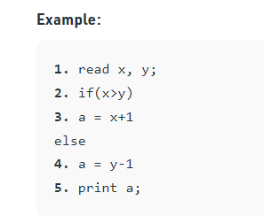
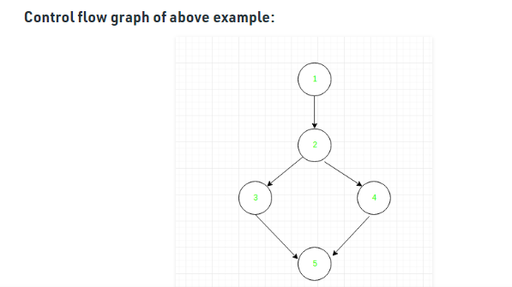
Data Flow Testing uses the control flow graph to find the situations that can interrupt the flow of the program.

Slide 57
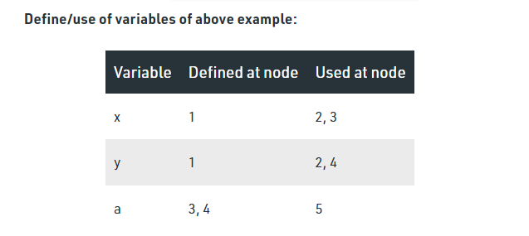

Slide 58
Making associations
In this technique, we make associations between two kinds of statements:
Where variables are defined
Where those variables are used

Slide 59
Domain Testing
Domain Testing is a Software Testing process in which the application is tested by giving a minimum number of inputs and evaluating its appropriate outputs.
The primary goal of Domain testing is to check whether the software application accepts inputs within the acceptable range and delivers required output.

Slide 60
It is a Functional Testing technique in which the output of a system is tested with a minimal number of inputs to ensure that the system does not accept invalid and out of range input values.
It is one of the most important White Box Testing methods. It also verifies that the system should not accept inputs, conditions and indices outside the specified or valid range.
In domain testing, we divide a domain into sub-domains (equivalence classes) and then test using values from each subdomain. For example, if a website (domain) has been given for testing, we will be dividing the website into small portions (subdomain) for the ease of testing.
Domain might involve testing of any one input variable or combination of input variables.

Slide 61
Domain Testing Strategy
While domain testing, you need to consider following things,
What domain are we testing?
How to group the values into classes?
Which values of the classes to be tested?
How to determine the result?

Slide 62
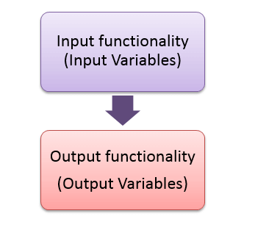
What domain are we testing?
Any domain which we test has some input functionality and an output functionality. There will be some input variables to be entered, and the appropriate output has to be verified

Slide 63
Domain Testing Example
Consider a single input test scenario:
C = a+b, where a and b are input variables and C is the output variable.
Here in the above example, there is no need of classification or combination of the variables is required.
Consider the below multiple inputs and appropriate output scenario:
Consider a games exhibition for Children, 6 competitions are laid out, and tickets have to be given according to the age and gender input. The ticketing is one of the modules to be tested in for the whole functionality of Games exhibition.

Slide 64
According to the scenario, we got six scenarios based on the age and the competitions:
Age >5 and <10, Boy should participate in Storytelling.
Age >5 and <10 , girl should participate in Drawing Competition.
Age >10 and <15, Boy should participate in Quiz.
Age >10 and <15 , girl should participate in Essay writing.
Age<5, both boys and girls should participate in Rhymes Competition.
Age >15, both boys and girls should participate in Poetry competition.

Slide 65
How to group the values into classes?
Partitioning some values means splitting it into non-overlapping subsets.
As we discussed earlier there are two types of partitioning:
Equivalence partitioning – Equivalence partitioning is a software testing technique that divides the input data of a software unit into partitions of equivalent data from which test cases can be derived. In principle, test cases are designed to cover each partition at least once.
Boundary value analysis – Boundary value analysis is a software testing technique in which tests are designed to include representatives of boundary values in a range. The idea comes from the boundary.

Slide 66
For the above example, we are partitioning the values into a subset or the subset. We are partitioning the age into the below classes :
Class 1: Children with age group 5 to 10
Class 2 : Children with age group less than 5
Class 3: Children with age group age 10 to 15
Class 4: Children with age group greater than 15.

Slide 67
Domain Testing Structure
Identify the potentially interesting variables.
Identify the variable(s) you can analyze now and order them (smallest to largest and vice versa).
Create and identify boundary values and equivalence class values as above.
Identify secondary dimensions and analyze each in a classical way. (In the above example, Gender is the secondary dimension).
Identify and test variables that hold results (output variables).
Evaluate how the program uses the value of this variable.
Identify additional potentially-related variables for combination testing.
Imagine risks that don’t necessarily map to an obvious dimension.
Identify and list unanalyzed variables. Gather information for later analysis.
Summarize your analysis with a risk/equivalence table.

Slide 68
What is Functional Testing?
FUNCTIONAL TESTING is a type of software testing that validates the software system against the functional requirements/specifications.
The purpose of Functional tests is to test each function of the software application, by providing appropriate input, verifying the output against the Functional requirements.
Functional testing mainly involves black box testing and it is not concerned about the source code of the application.
This testing checks User Interface, APIs, Database, Security, Client/Server communication and other functionality of the Application Under Test. The testing can be done either manually or using automation.

Slide 69
What do you test in Functional Testing?
The prime objective of Functional testing is checking the functionalities of the software system. It mainly concentrates on –
Mainline functions: Testing the main functions of an application
Basic Usability: It involves basic usability testing of the system. It checks whether a user can freely navigate through the screens without any difficulties.
Accessibility: Checks the accessibility of the system for the user
Error Conditions: Usage of testing techniques to check for error conditions. It checks whether suitable error messages are displayed.

Slide 70
Following is a step by step process on How to do Functional Testing :
Understand the Functional Requirements
Identify test input or test data based on requirements
Compute the expected outcomes with selected test input values
Execute test cases
Compare actual and computed expected results

Slide 71
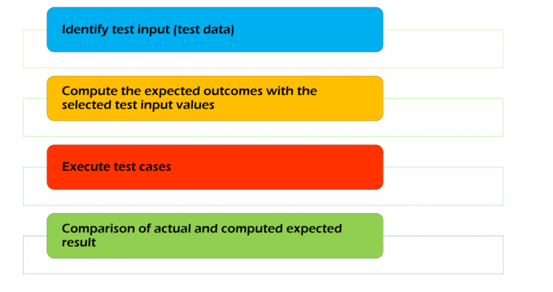

Slide 72
Major Functional Testing Techniques:
Unit Testing
Integration Testing
Smoke Testing
User Acceptance Testing
Interface Testing
Usability Testing
System Testing
Regression Testing

Slide 73
Advantages of Functional Testing:
It ensures to deliver a bug-free product.
It ensures to deliver a high-quality product.
No assumptions about the structure of the system.
This testing is focused on the specifications as per the customer usage.
Disadvantages of Functional Testing:
There are high chances of performing redundant testing.
Logical errors can be missed out in the product.
If the requirement is not complete then performing this testing becomes difficult.

Slide 74
Mutation Testing
Mutation Testing is a type of software testing in which certain statements of the source code are changed/mutated to check if the test cases are able to find errors in source code.
The goal of Mutation Testing is ensuring the quality of test cases in terms of robustness that it should fail the mutated source code.
The changes made in the mutant program should be kept extremely small that it does not affect the overall objective of the program.
Mutation Testing is also called Fault-based testing strategy as it involves creating a fault in the program and it is a type of White Box Testing which is mainly used for Unit Testing.

Slide 75
MT is also known as fault-based testing, program mutation, error-based testing, or mutation analysis.

Slide 76
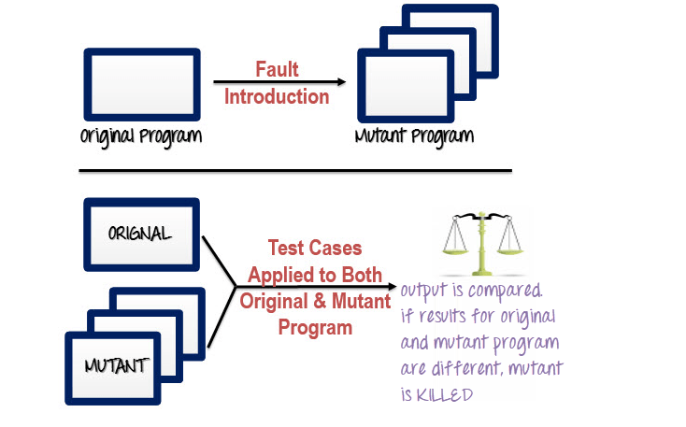
How to execute Mutation Testing?

Slide 77
Mutations introduced to a program’s code will typically be small and contain one variable which causes a fault or bug.
Multiple versions of the original program are then made, each with its own mutation, called mutants.
The mutants are then tested, along with the original application.
Once the tests are conducted, testers should then compare the results to the original program test.

Slide 78
The mutants can be kept and re-used in another code mutation test once the testing software has been worked on.
If the test results from the mutants to the original programs are different, with the software test detecting the faults in the mutants, then the mutants can be discarded, or killed.

Slide 79
Mutants: It is simply the mutated version of the source code. It is the code that contains minute changes. When the test data is run through the mutant, it should ideally give us different results from the original source code. Mutants are also called mutant programs.
There are different types of mutants. These are as follows:
Survived Mutants: As we have mentioned, these are the mutants that are still alive after running test data through the original and mutated variants of the source code. These must be killed. They are also known as live mutants.
Killed Mutants: These are mutants that are killed after mutation testing. We get these when we get different results from the original and mutated versions of the source code.
Equivalent Mutants: These are closely related to live mutants, in that, they are ‘alive’ even after running test data through them. What differentiates them from others is that they have the same meaning as the original source code, even though they may have different syntax.

Slide 80
Following are the steps to execute mutation testing(mutation analysis):
Step 1: Faults are introduced into the source code of the program by creating many versions called mutants. Each mutant should contain a single fault, and the goal is to cause the mutant version to fail which demonstrates the effectiveness of the test cases.
Step 2: Test cases are applied to the original program and also to the mutant program. A Test Case should be adequate, and it is tweaked to detect faults in a program.
Step 3: Compare the results of an original and mutant program.
Step 4: If the original program and mutant programs generate the different output, then that the mutant is killed by the test case. Hence the test case is good enough to detect the change between the original and the mutant program.
Step 5: If the original program and mutant program generate the same output, Mutant is kept alive. In such cases, more effective test cases need to be created that kill all mutants.

Slide 81
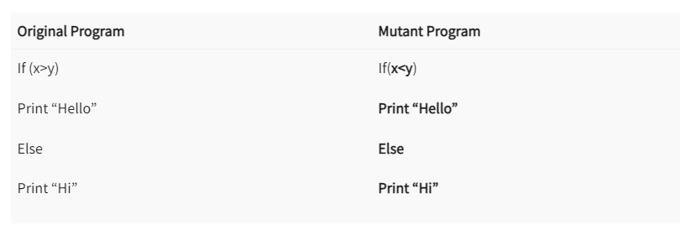
How to Create Mutant Programs?
A mutation is nothing but a single syntactic change that is made to the program statement. Each mutant program should differ from the original program by one mutation.

Slide 82
Types of Mutation Testing
In Software Engineering, Mutation testing could be fundamentally categorized into 3 types– statement mutation, decision mutation, and value mutation.
Statement Mutation – developer cut and pastes a part of a code of which the outcome may be a removal of some lines
Value Mutation– values of primary parameters are modified
Decision Mutation– control statements are to be changed
https://www.softwaretestinghelp.com/what-is-mutation-testing/

Slide 83
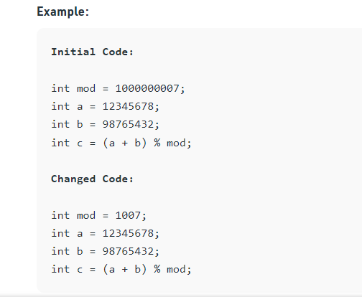
Value Mutations: In this type of testing the values are changed to detect errors in the program. Basically a small value is changed to a larger value or a larger value is changed to a smaller value. In this testing basically constants are changed.

Slide 84
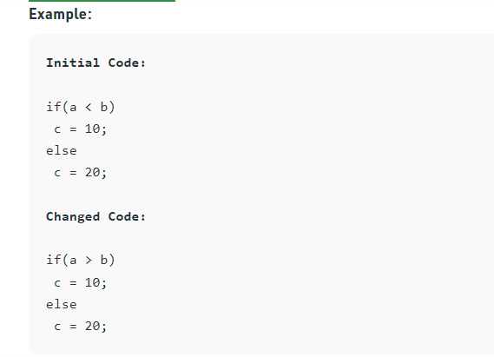
Decision Mutations: In decisions mutations are logical or arithmetic operators are changed to detect errors in the program.

Slide 85
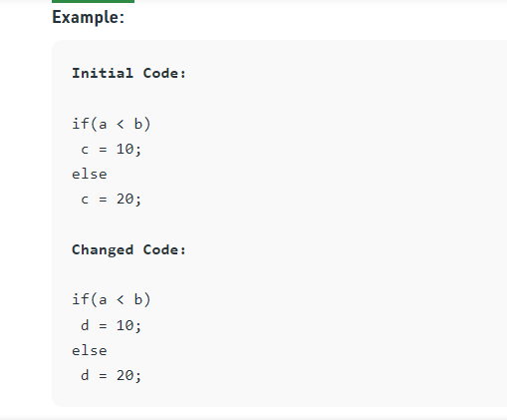
Statement Mutations: In statement mutations a statement is deleted or it is replaces by some other statement.

Slide 86
Mutators/mutation operators: These are what makes mutations possible, they are on the ‘driver’s seat’.
They basically define the kind of alteration or change to make to the source code to have a mutant version.
They can be referred to as faults or mutation rules.

Slide 87
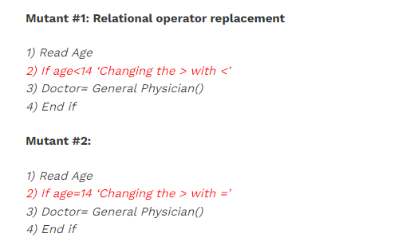
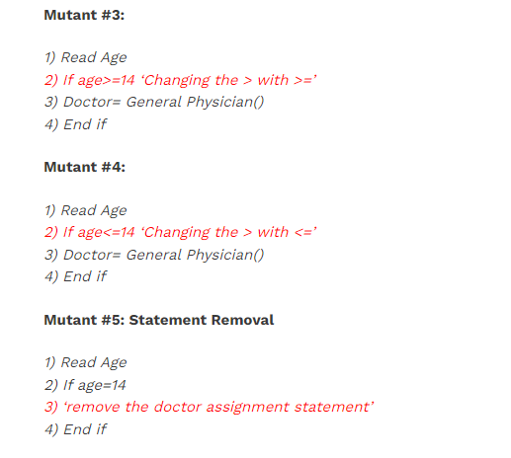
replacements are also called ‘Mutation Operators.’

Slide 88
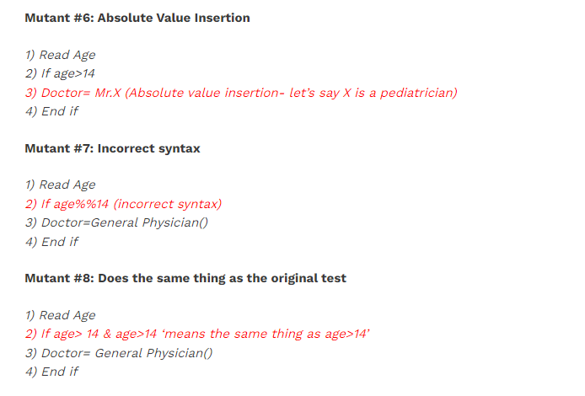

Slide 89
Mutation Score:
The mutation score is defined as the percentage of killed mutants with the total number of mutants.
Mutation Score = (Killed Mutants / Total number of Mutants) * 100
Test cases are mutation adequate if the score is 100%. Experimental results have shown that mutation testing is an effective approach for measuring the adequacy of the test cases.
But, the main drawback is that the high cost of generating the mutants and executing each test case against that mutant program.

Slide 90
Advantages of Mutation Testing:
Following are the advantages of Mutation Testing:
It is a powerful approach to attain high coverage of the source program.
This testing is capable comprehensively testing the mutant program.
Mutation testing brings a good level of error detection to the software developer.
This method uncovers ambiguities in the source code and has the capacity to detect all the faults in the program.
Customers are benefited from this testing by getting a most reliable and stable system.

Slide 91
Disadvantages of Mutation Testing:
On the other side, the following are the disadvantages of Mutant testing:
Mutation testing is extremely costly and time-consuming since there are many mutant programs that need to be generated.
Since its time consuming, it’s fair to say that this testing cannot be done without an automation tool.
Each mutation will have the same number of test cases than that of the original program. So, a large number of mutant programs may need to be tested against the original test suite.
As this method involves source code changes, it is not at all applicable for Black Box Testing

Slide 92
What is Junit?
https://www.guru99.com/junit-tutorial.html
JUnit is an open source Unit Testing Framework for JAVA.
It is useful for Java Developers to write and run repeatable tests.
Erich Gamma and Kent Beck initially develop it. It is an instance of xUnit architecture.
As the name implies, it is used for Unit Testing of a small chunk of code.
Developers who are following test-driven methodology must write and execute unit test first before any code.
Once you are done with code, you should execute all tests, and it should pass. Every time any code is added, you need to re-execute all test cases and makes sure nothing is broken.

Slide 93
Why you need JUnit testing
It finds bugs early in the code, which makes our code more reliable.
JUnit is useful for developers, who work in a test-driven environment.
Unit testing forces a developer to read code more than writing.
You develop more readable, reliable and bug-free code which builds confidence during development.
JUnit plays a huge role when it comes to regression testing. Regression Testing is a type of software testing that checks if the recent changes made to the code do not adversely affect the previously written code.

Slide 94
Features of JUnit
There are several features of JUnit that make it so popular. Some of them are as follows:
Open Source Network:
JUnit is an open-source network that enables developers to write codes fast and with better quality.
Provides Annotations:
It provides several annotations to identify test methods.
Provides Assertions:
There are assertions to test expected results.
Provides Test Runners:
JUnit has test runners to run tests.

Slide 95
Improves Code Quality:
JUnit is the most popular testing framework for efficient testing. It allows faster code writing, which results in an increase in the code’s quality.
Automated Test Running:
The test results do not require manual checking. All the tests run automatically on JUnit, the results obtained are in automatically checked, and it provides feedback.

Slide 96
It is an open-source testing framework for java programmers. The java programmer can create test cases and test his/her own code.
It is one of the unit testing framework. Current version is junit 4.
To perform unit testing, we need to create test cases. The unit test case is a code which ensures that the program logic works as expected.

Slide 97
Types of unit testing
There are two ways to perform unit testing: 1) manual testing 2) automated testing.
1) Manual Testing
If you execute the test cases manually without any tool support, it is known as manual testing. It is time consuming and less reliable.
2) Automated Testing
If you execute the test cases by tool support, it is known as automated testing. It is fast and more reliable.

Slide 98
Features of JUnit Test Framework
JUnit test framework provides the following important features
Fixtures
Test suites
Test runners
JUnit classes

Slide 99
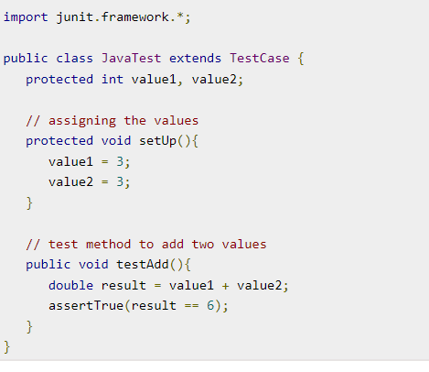
Fixtures
Fixtures is a fixed state of a set of objects used as a baseline for running tests. The purpose of a test fixture is to ensure that there is a well-known and fixed environment in which tests are run so that results are repeatable. It includes −
setUp() method, which runs before every test invocation.
tearDown() method, which runs after every test method.

Slide 100
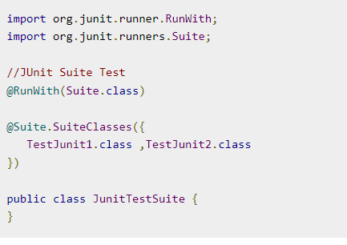
Test Suites
A test suite bundles a few unit test cases and runs them together. In JUnit, both @RunWith and @Suite annotation are used to run the suite test.

Slide 101
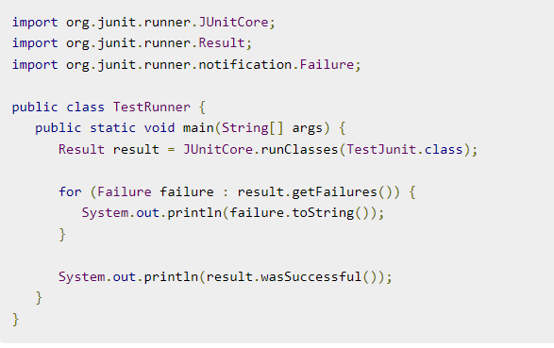
Test Runners
Test runner is used for executing the test cases. Here is an example that assumes the test class TestJunit already exists.

Slide 102
JUnit Classes
JUnit classes are important classes, used in writing and testing JUnits. Some of the important classes are −
Assert − Contains a set of assert methods.
TestCase − Contains a test case that defines the fixture to run multiple tests.
TestResult − Contains methods to collect the results of executing a test case.

Slide 103
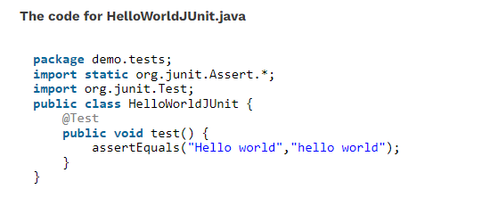
Examples Of JUnit Testcase
Example #1:
Here is a JUnit testcase HelloWorldJUnit.java that verifies that the string “Hello world” matches the string “hello world” which fails on execution, as the match is case sensitive. Hence, the two strings don’t match and the test fails.

Slide 104
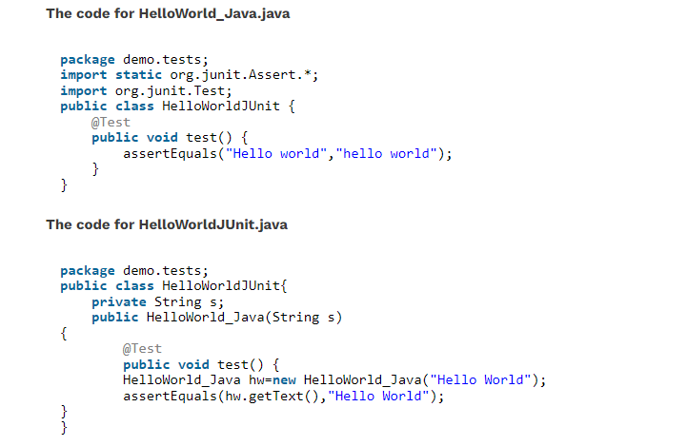
Example #2:
Here, we will see how a usual Java class file interacts with a JUnit testcase. We create a Java class file HelloWorld_Java.java with a constructor that allows us to pass a String value and a method getText() to fetch the string value.
JUnit Test class HelloWorldJUnit.java is created such that the class object for HelloWorld_Java is created and the actual string value is passed to the object. The assertEquals() from JUnit verifies if the expected and actual string values match.

